Slide 1

ObjecTally: Template-Based Counting
Major Project Presentation
Presented by_
Salman Faizi , Ayub Alam Md Zunnurain , Ayan Pramanik Subarna Das

Slide 2

Project Members
Team Members
The project involves multiple team members who contributed significantly to the research and development.
Team members include Salman Faizi, Ayub Alam, Ayan Pramanik, Subarna Das, and Md Zunnurain.
Each team member had a specific role and worked in synchronization for achieving the project goals.
The dedication and hard work of the team members were appreciated by the supervisor.

Slide 3

Project Guide
Supervision
The project was guided under the supervision of Arijit Hajra, CEO of Think Again Lab.
His guidance was crucial in ensuring the project's success and achieving its objectives.
Arijit Hajra provided valuable insights and mentoring throughout the project's development.
His supervision ensured that the project adhered to industry standards and practices.

Slide 4
Table of Contents
01
Introduction to ObjecTally
06
Challenges Faced
02
Objective of ObjecTally
07
Achievements
03
Background Study
08
Project Demo
04
Data Collection and Preparation
09
Conclusion and Future Scope
05
Workflow
06
Technical Approach

Slide 5

Introduction to ObjecTally
Project Overview
A cutting-edge project developed by a team of dedicated CSE students specializing in AI & ML at The Neotia University.
Focuses on template-based counting using deep learning models to accurately count objects within specific categories in images.

Slide 6
Continue…
Key components:
Creating a custom dataset.
Manually Annotating the data.
Training the model on the created dataset template-wise.
Finally counting and evaluating on the real-world data.
Design and develop web app.
Aims to enhance accuracy in various applications:
Retail inventory management.
Material counting like bricks, pipes, beams etc.
Crowd counting.
Wildlife population monitoring.

Slide 7

Objective of ObjecTally
Project Goals
The main objective of ObjecTally is to develop a template-based counting system.
The project aims to provide accurate counting mechanisms using AI techniques.
It focuses on creating a reliable and efficient system that can count objects accurately and reduce manually effort.

Slide 8
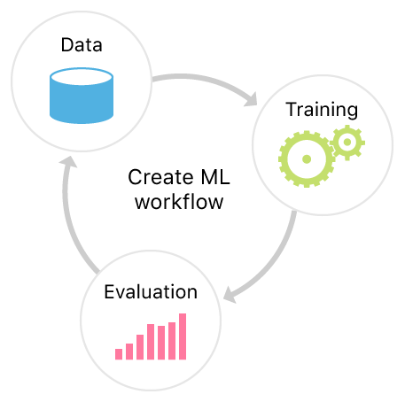
Objectives
Create a custom annotated dataset.
Train a deep learning model for object detection and localization.
Implement a counting mechanism.
Evaluate performance on benchmark datasets and real-world scenarios.

Slide 9


Background Study
Manual Counting: Time-consuming and error-prone.
Automated Counting: Often lacks accuracy in complex scenarios.
Model-Based Counting: Uses predefined models for accurate and robust counting.

Slide 10
Complete workflow

Slide 11


Data Collection and Preparation
Data Collection: Collect various types of image data from multiple sources based on requirement.
Data Annotation: Manually Annotate Images with segmentation masks on the roboflow website.
Data Pre-processing: Techniques like normalization and image resizing to 640x640.
Data Augmentation: Techniques like cropping, flipping, and brightness adjustments.

Slide 12
Technical Approach
Methodology
The project uses AI and DL techniques to design and implement the counting system.
It follows a structured methodology to ensure the accuracy and reliability of the results.
The technical approach involves several stages_
Data Collection: Create a custom dataset with annotated images.
Model Training: Train the YOLOv8n segment model.
Object Counting: Use connected components analysis on segmentation masks.
Evaluation: Measure accuracy against ground truth counts.

Slide 13
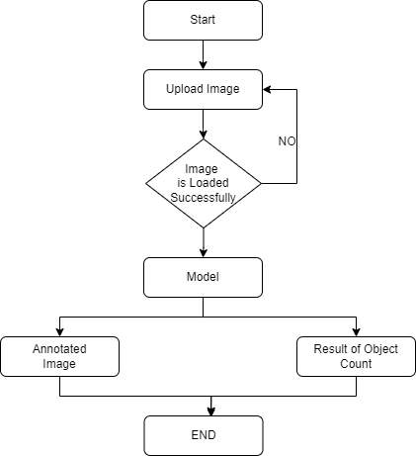
Workflow of web app

Slide 14
Model Training
Configuration: Customize YOLOv8 for segmentation.
Hyperparameters: Tuning learning rate, image size ,batch size, epochs.
Hardware: Use GPUs for faster training on platforms like Kaggle

Slide 15
Object Counting Process
Inference: Process new images to predict segmentation masks.
Connected Components Analysis: Identify and count objects.
Challenges: Dataset quality, GPU session limits, model performance issues.

Slide 16


Evaluation
Testing Dataset: Separate set of images not used in training.
Accuracy Metrics: Mean absolute error (MAE), percentage error.

Slide 17
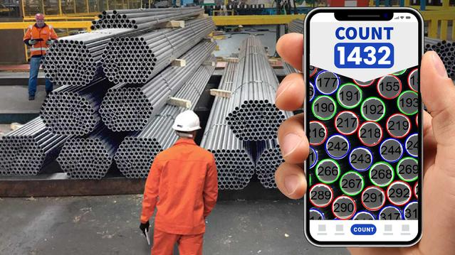
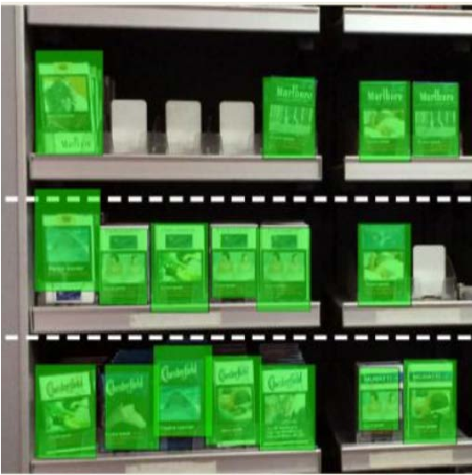
Results and Interpretation
Accuracy: Analysis of achieved accuracy and performance.
Scenarios: Where the model performed well and areas needing improvement.
Further Research: Enhance model performance in challenging scenarios.

Slide 18
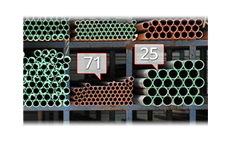
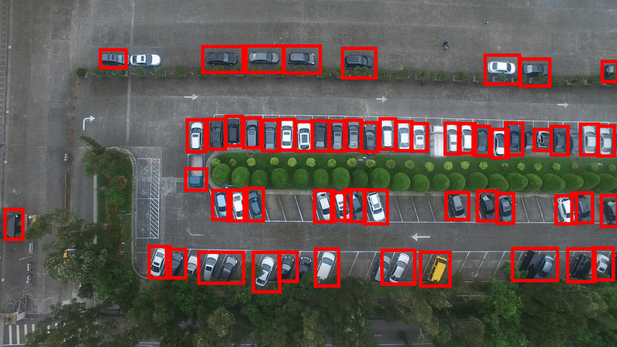
Real-World Applications
Applications: Traffic flow analysis, automated inventory management, ecological monitoring.
Example: Automated fruit inventory management in orchards.

Slide 19

Achievements
Outcomes
The project has achieved significant milestones in developing a reliable counting system.
It successfully demonstrates the application of AI and ML in practical scenarios.
The outcomes are aligned with the initial objectives and exceed the expectations of the supervisors.
The achievements are a testament to the hard work and dedication of the team members.

Slide 20

Project Presentation
Final Report
The final project report was presented as part of the B.Tech degree requirements.
This presentation includes detailed explanations and demonstrations of the ObjecTally system.
The report highlights the project's innovations, objectives, achievements, and challenges faced.
It serves as a comprehensive document demonstrating the project's scope and effectiveness.

Slide 21
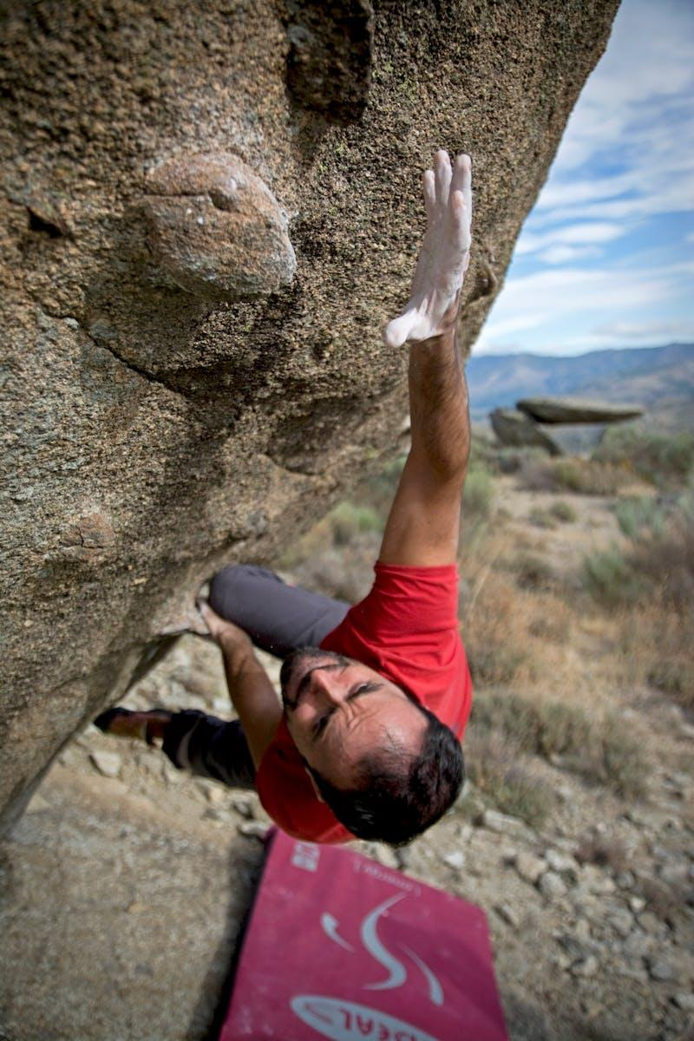
Challenges Faced
Obstacles
The project encountered several challenges during its development phase.
These challenges included technical difficulties, resource limitations, and time constraints.
Despite the obstacles, the team managed to overcome them with dedicated effort.
The experience of tackling challenges contributed to the learning curve of the team.

Slide 22

Conclusion and Future Scope
Looking Ahead
The project concludes with significant accomplishments in template-based counting systems.
Future scope includes expanding the system's capabilities and integrating advanced AI models.
The project sets a foundation for further research and development in this domain.
Future enhancements can improve accuracy and broaden the application's scope.

Slide 23

Questions & Answers
We welcome your questions and feedback. Thank you for your attention!

Slide 24


